Slide 1

Analysis 1: Foundations of Modeling Lesson 6.2: Lists in Python
Analysis Team, 2020/2021

Slide 2
Overview of this lesson: Lists in Python
Lists in Python,
What is a list,
Creating lists, accessing and counting items,
Adding and removing items,
Iteration and slicing,
Concatenation, repetition and other handy methods,
List comprehension,
Python’s data object model,
Assignment vs shallow and deep copy

Slide 3
Overview of this lesson: Lists in Python
Learning objectives:
Learn how to use Lists in Python.
Understand Python’s data object model.
Understand the difference between assigning and copying the same data object.
At the end of the lesson a student should be able to:
Use lists and list operations in Python.

Slide 4
Lists
List is a data structure in Python.
List is a mutable, ordered sequence of items.
Each value contained inside a list is called an item or a member.
Items can by any data type, such as integers, floats, characters, strings, sets, other lists and many more.
Typically, lists are defined by listing values, separated by commas (,) between square brackets [ ].

Slide 5
Lists
Programmers use lists when working with many related values.
Lists enable programmers to:
keep data together,
condense code,
perform same methods and operations on multiple values at once.
Unlike tuples and strings, lists are mutable – elements of the list can be altered.

Slide 6
Lists
elements
['foo', 'bar' , 'baz', 'qux' , 'quux' , 'corge’]
indices
* image source: realpython.com

Slide 7
Working with lists in Python

Slide 8
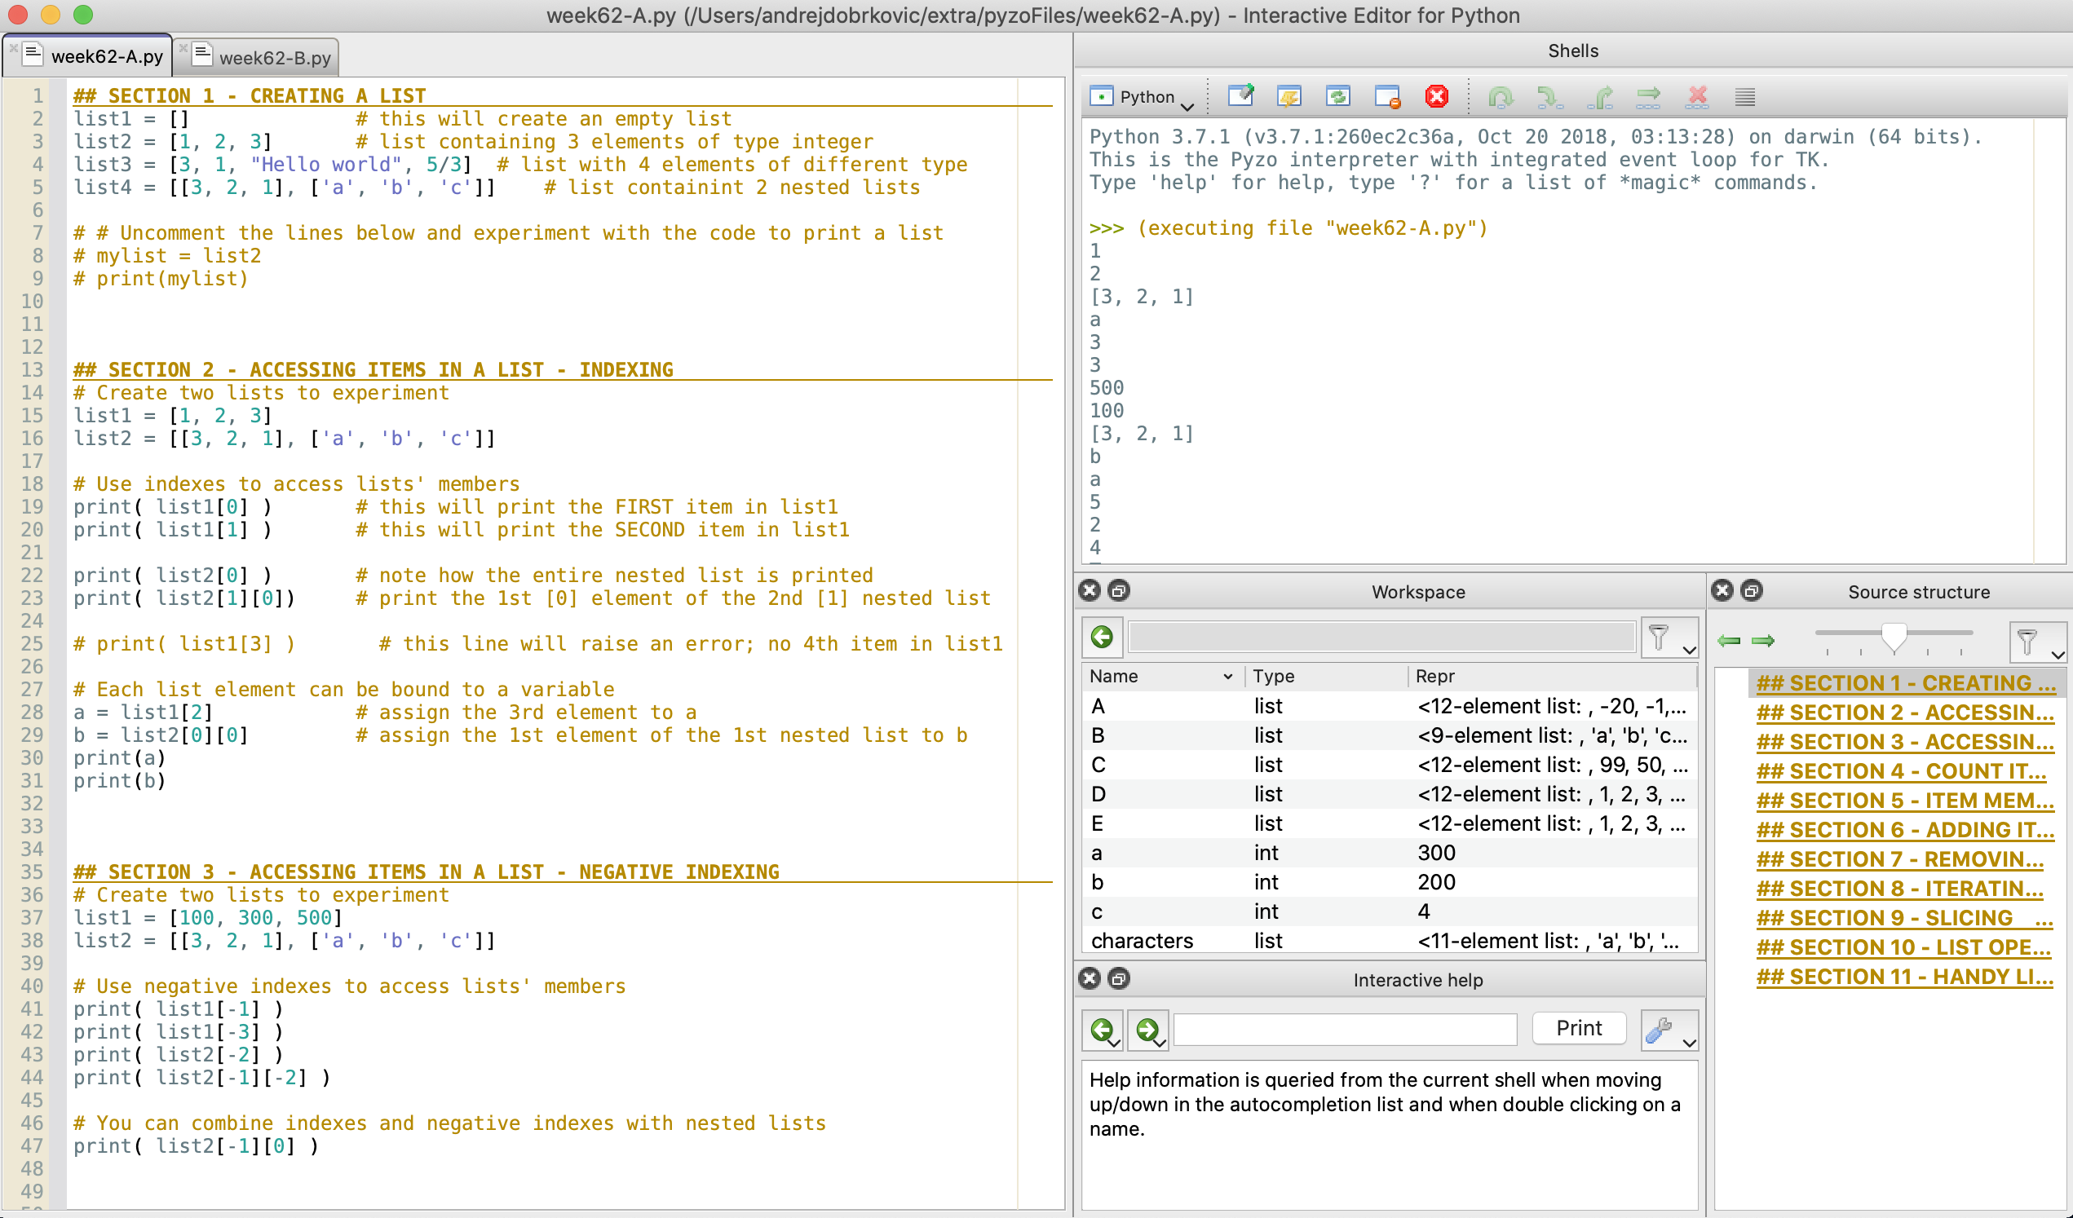
Code for the examples
This lesson shows:
How to create a list in Python,
How to access list items,
How to count items in a list,
How to add list items,
How to remove list items,
How to iterate through a list,
List slicing,
Common list operators and useful methods.
Every example from the slides is implemented in the file week62-A.py.
The file provides more details and examples, so it is strongly recommended to thoroughly examine it and experiment with the given code.

Slide 9
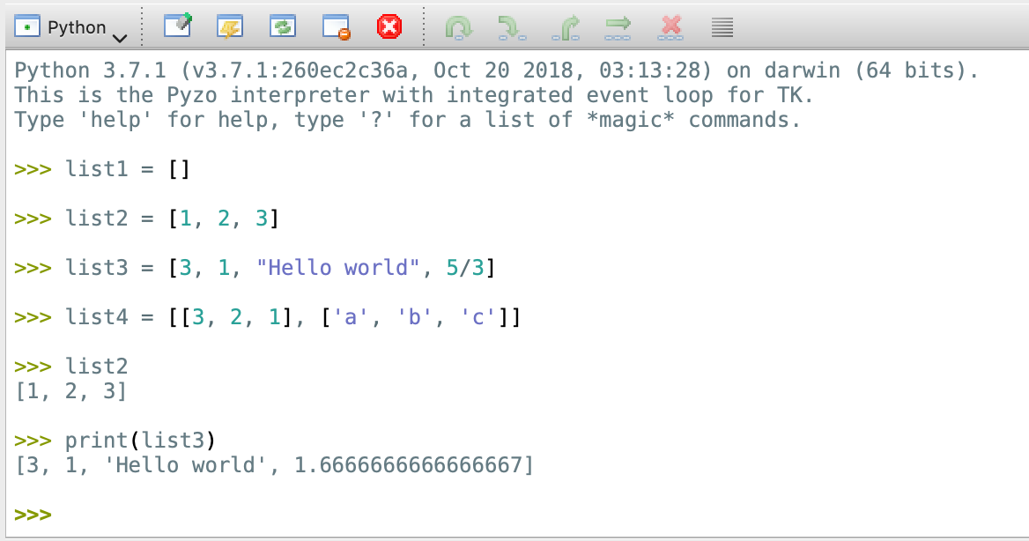
Creating a list
In Python, lists are created using square brackets ​[ ]​. Inside square brackets are given items, separated with comma (,) signs.
Python lists can contain any number of items with different data types.
If no elements are given, Python will create an empty list.
Try:
list1 = []
list2 = [1, 2, 3]
list3 = [3, 1, "Hello world", 5/3]
list4 = [[3, 2, 1], ['a', 'b', 'c']]

Slide 10
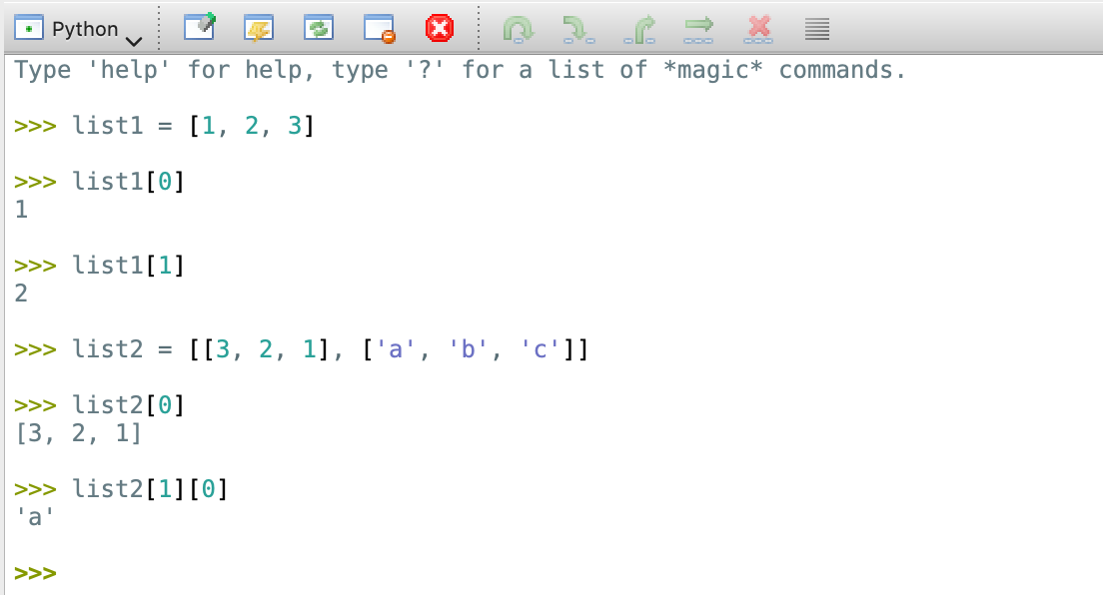
Accessing list items - indexing
As lists are ordered sequence of elements, each element has an assigned index value.
Python starts indexing with 0.
Index must be an integer.
To access item via index, use [ ] .
Try:
list1 = [1, 2, 3]
list1[0]
list1[1]
list2 = [[3, 2, 1], ['a', 'b', 'c’]]
list2[0]
list2[1][0]

Slide 11
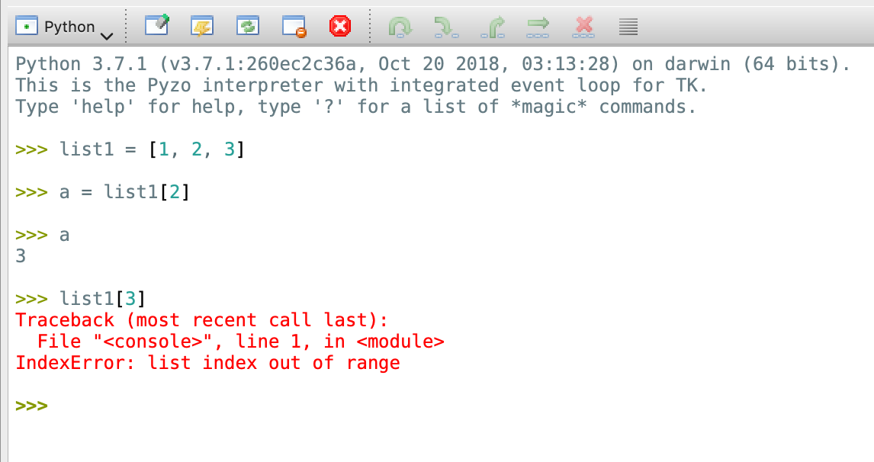
Accessing list items - indexing
Every element can be bound to a variable.
Try:
a = list1[2]
print(a)
Python raises an error if an index is used that is outside of range.
Try:
list1[3]
As list1 has 3 elements, trying to access list1[3], which is the 4th element, raises an error.

Slide 12
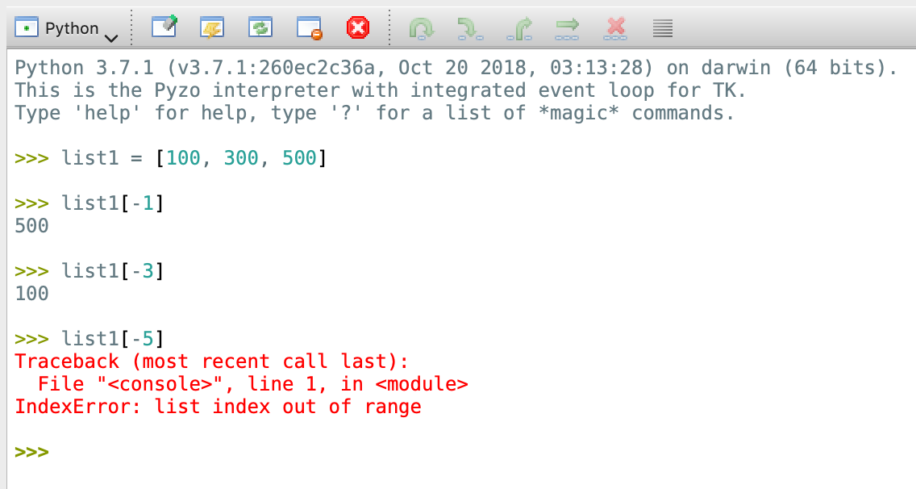
Accessing list items – negative indexing
To access list elements from the end, use negative indexing.
Note: in non-empty list, the last element has index -1.
Try:
list1 = [100, 300, 500]
list1[-1]
list1[-3]
list1[-5] # raises an error

Slide 13
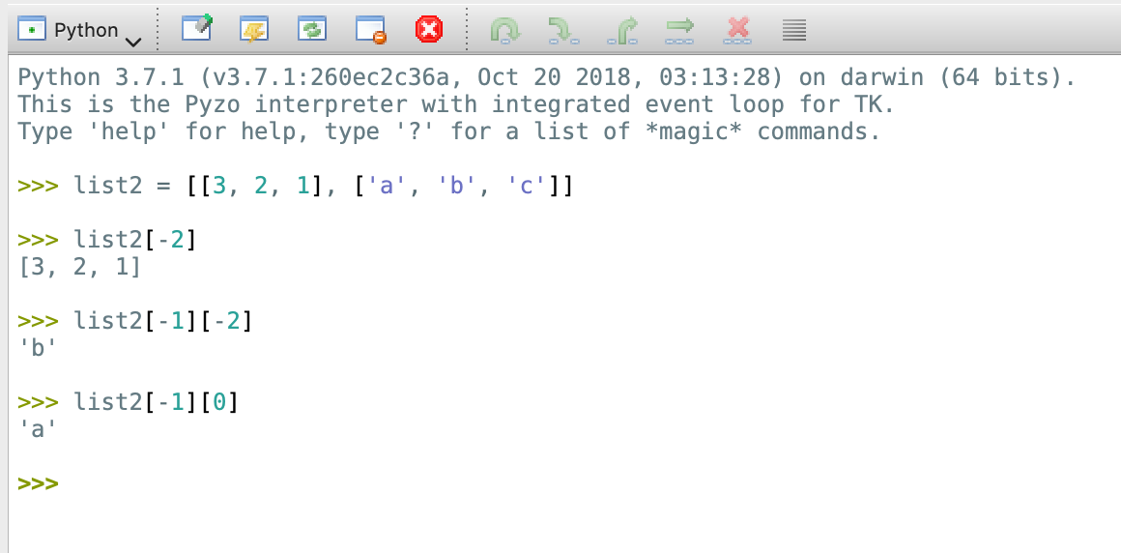
Accessing list items – negative indexing
Try:
list2 = [[3, 2, 1], ['a', 'b', 'c']]
list2[-2]
list2[-1][-2]
Positive and negative indexes can be used together, like in the example with our nested lists.
Try:
list2[-1][0]

Slide 14
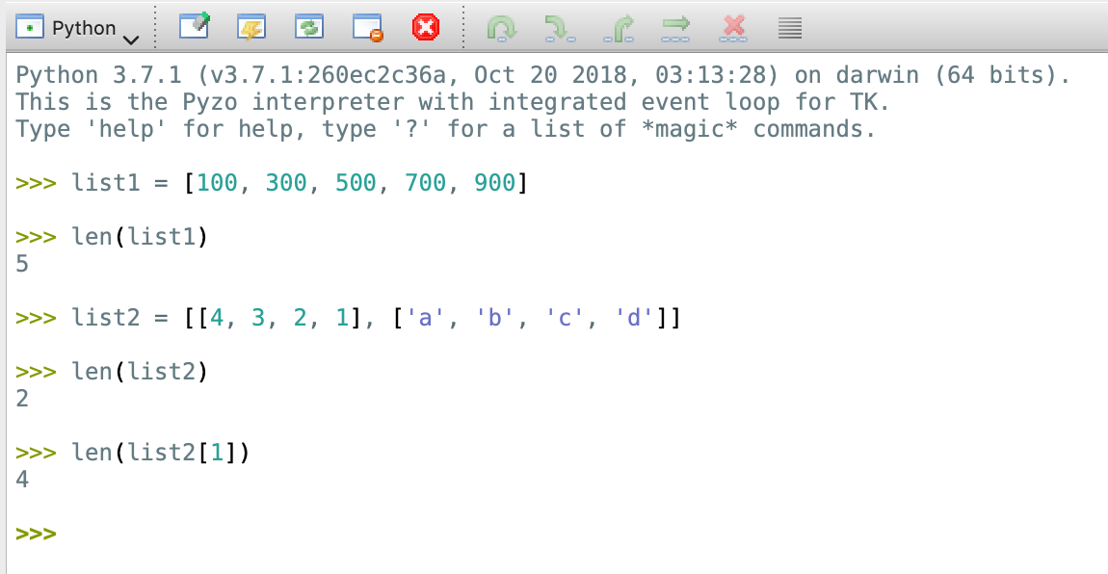
Counting items – len()
Like with sets, tuples and strings, len(list_variable) can be used to obtain the number of items in a list.
Try:
list1 = [100, 300, 500, 700, 900]
len(list1)
Be careful with nested lists!
Try:
list2 = [[4, 3, 2, 1], ['a', 'b', 'c', 'd’]]
len(list2)
len(list2[1])

Slide 15
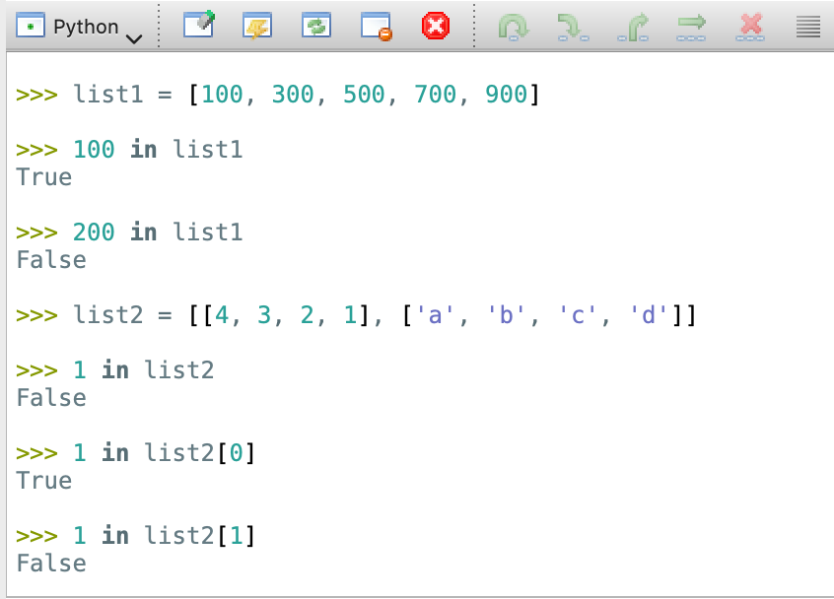
Testing membership - in
Similar to sets, in operator can be used to test membership.
in will give a Boolean value.
Try:
list1 = [100, 300, 500, 700, 900]
100 in list1
200 in list1
Be careful with nested lists! In this case, 1 is a member of list2[0], but not of list2.
Try:
list2 = [[4, 3, 2, 1], ['a', 'b', 'c', 'd’]]
1 in list2
1 in list2[0]
1 in list2[1]

Slide 16
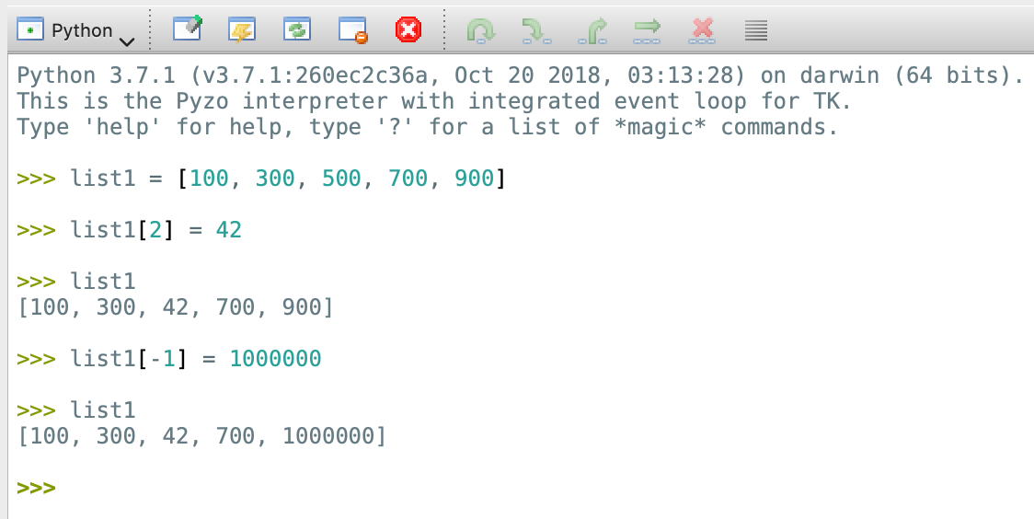
Updating list items
To update an item, use index to indicate which item you want to update, then assign a new value like for any other variable.
Try:
list1 = [100, 300, 500, 700, 900]
list1[2] = 42
print(list1)
list1[-1] = 1000000
print(list1)

Slide 17
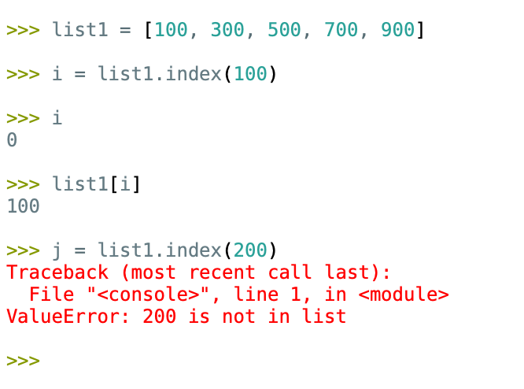
Finding index
If you need to find an index of an element, you can use ​.index(​item​_value)​ method.
Try:
list1 = [100, 300, 500, 700, 900]
i = list1.index(100)
print(i)
print(list1[i])
Passing a value to index that doesn’t exist will raise an error.

Slide 18
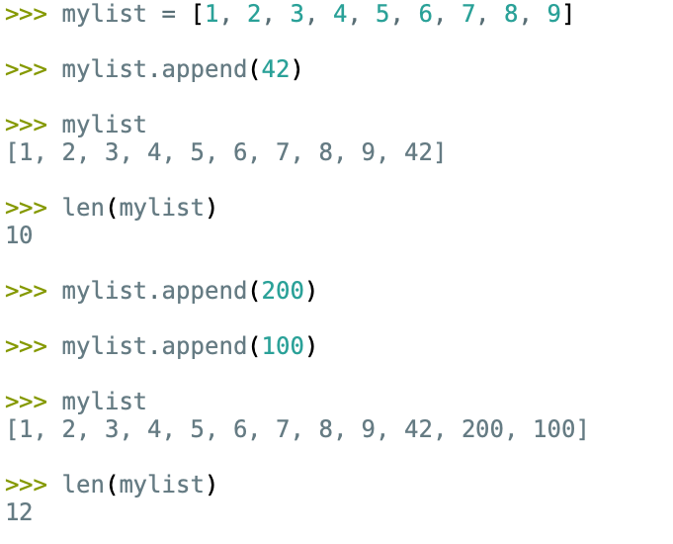
Adding items - append
There are two ways to add items to a list in Python:
.append (adds item at the end),
.insert (adds item at the given position).
Try:
mylist = [1, 2, 3, 4, 5, 6, 7, 8, 9]
mylist.append(42)
print(mylist)
print(len(mylist))
mylist.append(200)
mylist.append(100)
print(mylist)

Slide 19
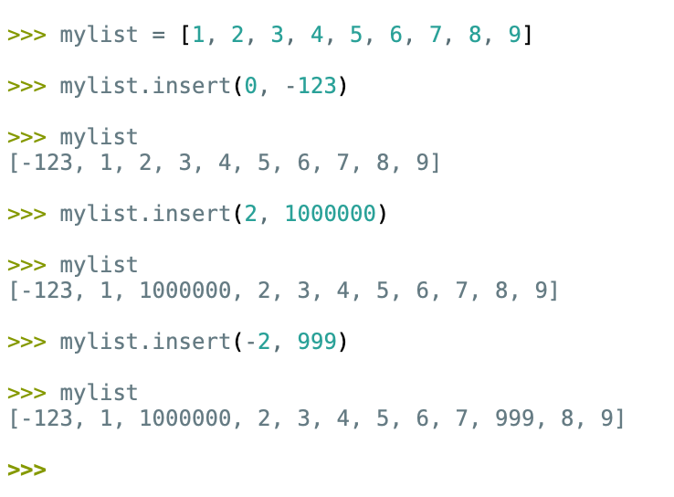
Adding items - insert
.insert needs two values. Index where to insert and the value to be inserted. Then, it will perform the insertion BEFORE the given index.
Try:
mylist = [1, 2, 3, 4, 5, 6, 7, 8, 9]
mylist.insert(0, -123)
print(mylist)
mylist.insert(2, 1000000)
print(mylist)
mylist.insert(-2, 999)
print(mylist)

Slide 20
Removing items
There are three ways to remove an item from a list:
Remove from the end using .pop() method,
Deleting an item with a given index using del() command,
Remove by a given value using .remove() method.
Note: If there are multiple elements with the same value, .remove() will remove the first one found (one with the lowest index).

Slide 21
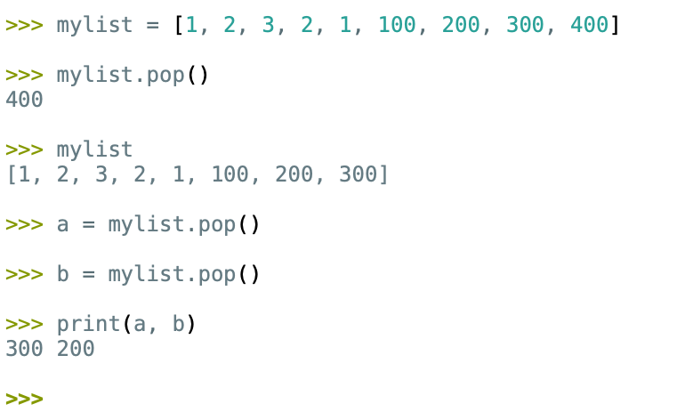
Removing items - pop
.pop() method removes the last element from the list.
Try:
mylist = [1, 2, 3, 2, 1, 100, 200, 300, 400]
mylist.pop()
print(mylist)
a = mylist.pop()
b = mylist.pop()
print(mylist)
Note: .pop() will also return the element removed, so it can be assigned to a variable if needed.

Slide 22
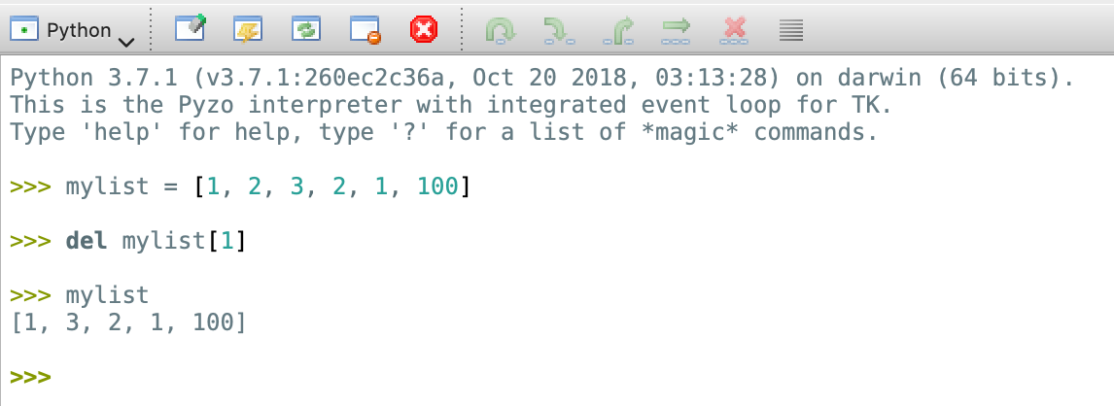
Removing items - del
Command del is used in Python to delete any variable from the memory.
Therefore, it can delete an entire list, or if a single list element is passed (with its index), it will be removed.
Try:
mylist = [1, 2, 3, 2, 1, 100]
del mylist[1]
print(mylist)

Slide 23
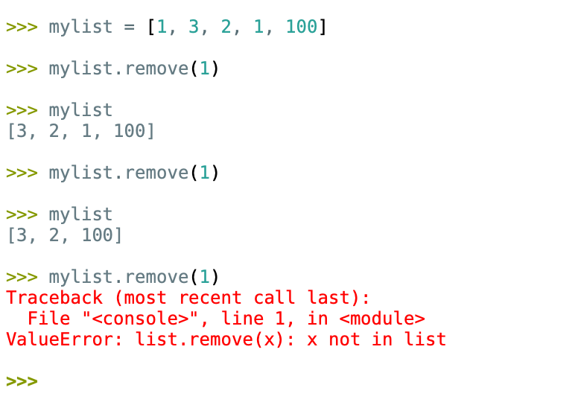
Removing items - remove
Method .remove() expects a value. If found, it will remove the first occurrence from the list.
Otherwise, .remove() will raise an error.
Try:
mylist = [1, 3, 2, 1, 100]
mylist.remove(1)
print(mylist)
mylist.remove(1)
print(mylist)
mylist.remove(1) # will raise an error

Slide 24
Iterating through elements

Slide 25
Iterating through elements
We learned that lists in Python are: (i) ordered, (ii) mutable (iii) sequences.
We also learned in lesson 5.2 that we can iterate over any sequence in Python using for loop.
Additinally, because lists are ordered, we can use for and range to access each element by its index.
This gives us two typical for loops to iterate through elements.

Slide 26
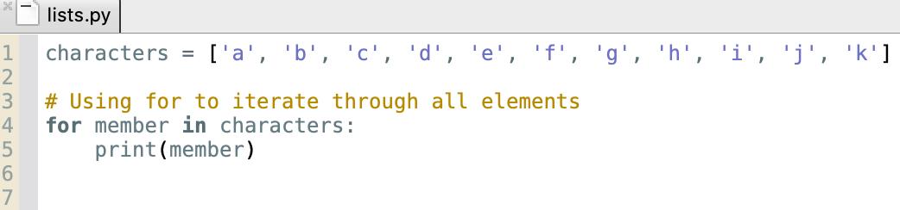
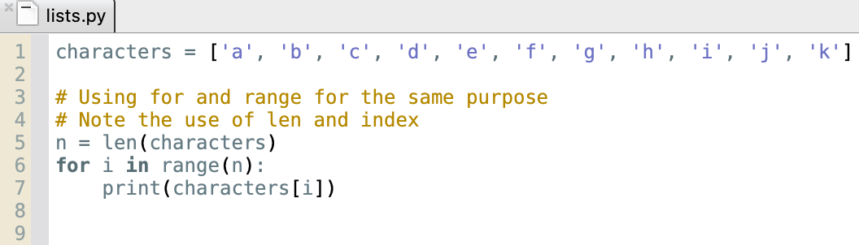
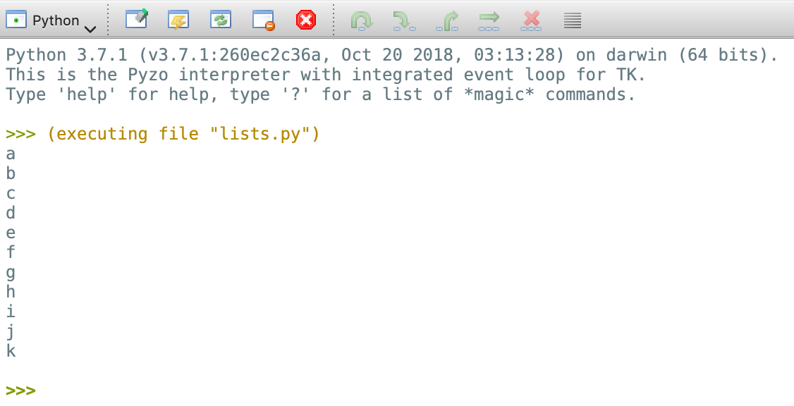
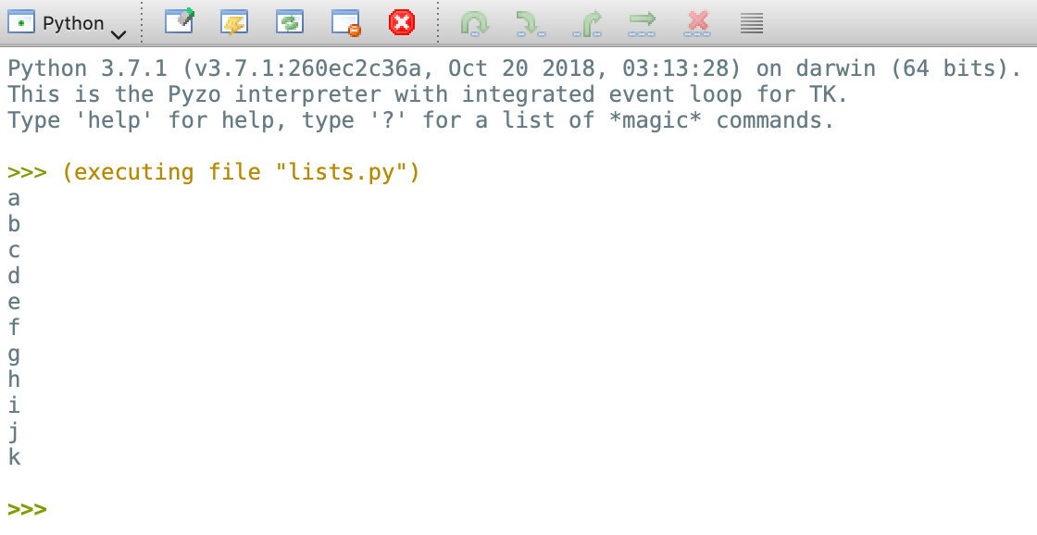
Iterating through elements
Iterate through all elements using for loop
Iterate through all elements using for loop and range

Slide 27
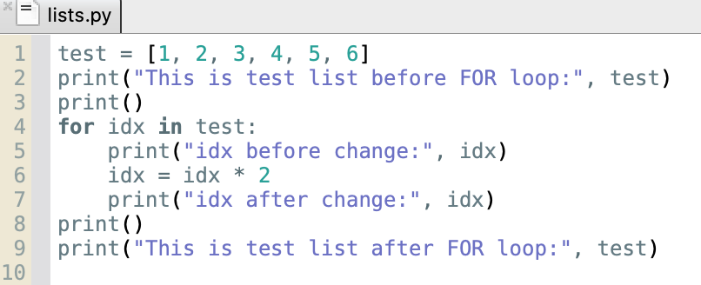
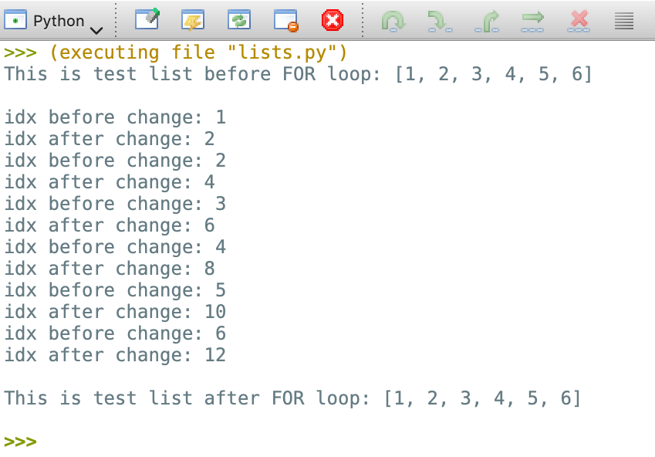
Iterating through elements
While iterating over a list using for command, the iterator will be assigned (bound) to every element of that list.
Changing the value of the iterator inside of for loop, will not affect list items*.
* (as long as list items are immutable)

Slide 28
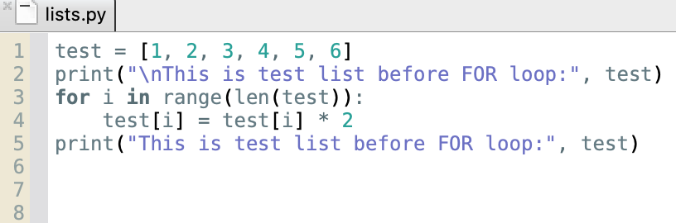
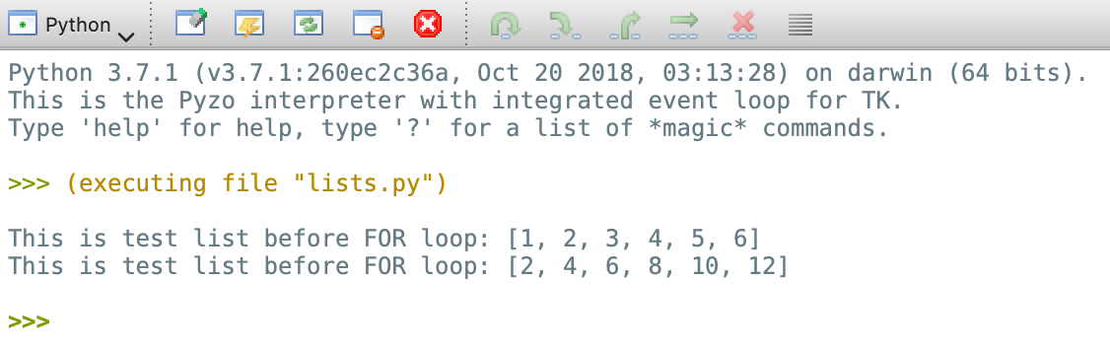
Iterating through elements
However, accessing items directly via index will always change them.

Slide 29
Slicing

Slide 30
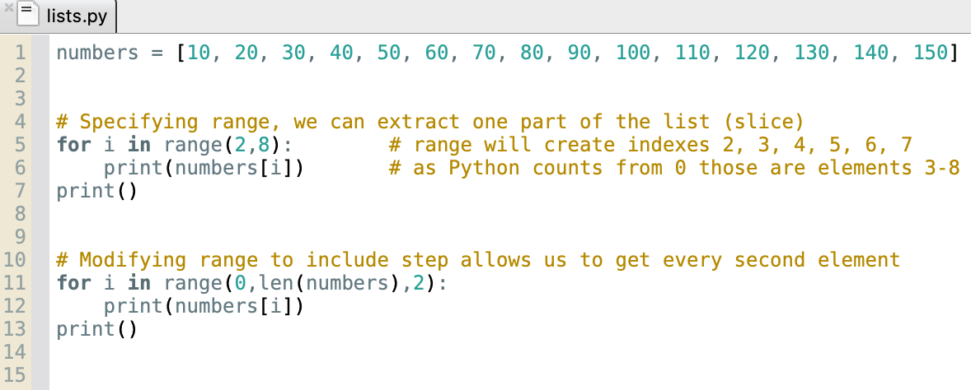
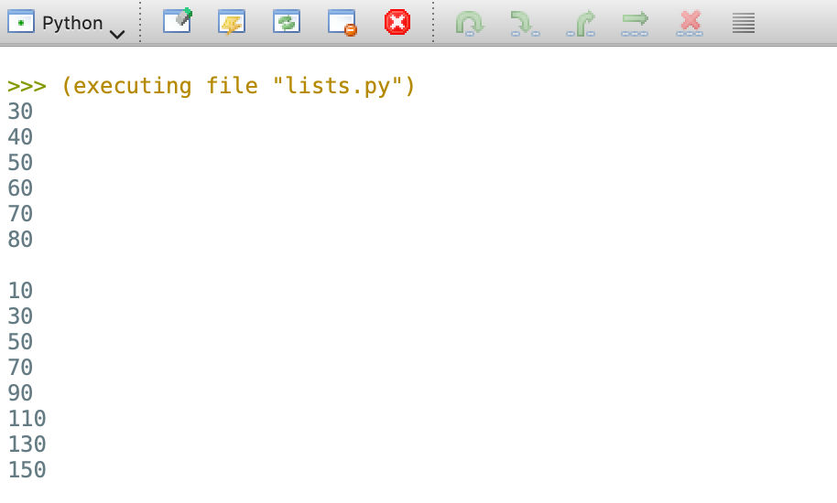
Slicing
Often, you will want to access only items from a specific range.
This can be accomplished by specifying start, stop and step parameters of range() command.
Exercise 1: modify range() to print all elements with indexes from 2 to (including) 7.
Exercise 2: modify range() to print every second element in the list.

Slide 31
Slicing
start_index is the first index to be included in the sub list.
If omitted, it defaults to 0.
In Python, creating a sub list from specified range (slice) can be accomplished in a single line.
Let’s take a closer look at the syntax:
list_name[ start_index : stop_index : step]
Step is the step size of the sequence.
It is optional and can be omitted.
If omitted, it defaults to 1.
stop_index indicates the element index where the sub list should stop.
Therefore, it will NOT be included in the sequence!!!
If omitted, it defaults to len(list_name), i.e. the last element + 1.
A list or a variable name containing a list.
Slice parameters are given inside of square brackets [ ]
and separated with colon : .

Slide 32
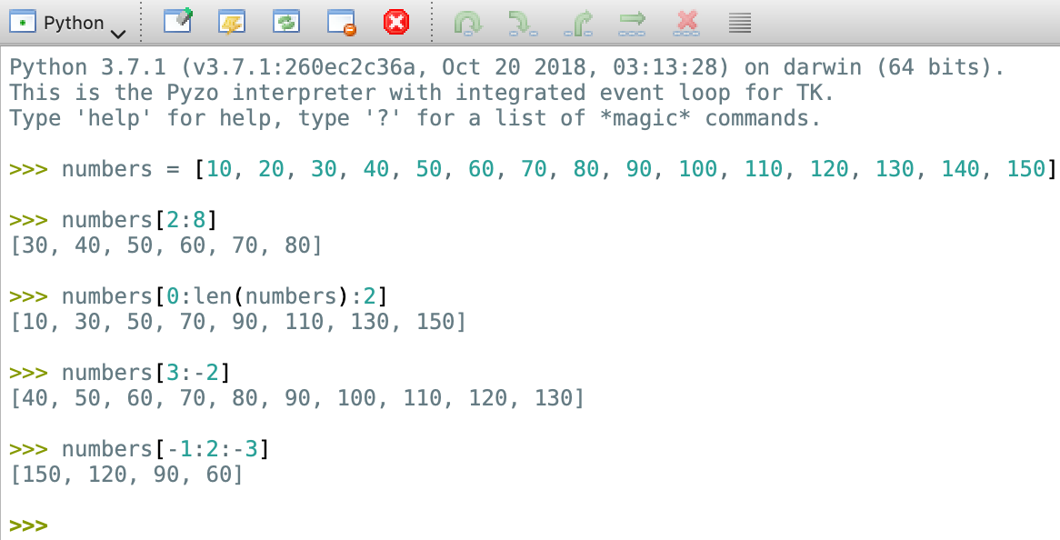
Slicing
Experiment with slicing.
Try:
numbers = [10, 20, 30, 40, 50, 60, 70, 80, 90, 100, 110, 120, 130, 140, 150]
numbers[2:8]
numbers[0:len(numbers):2]
Negative indexes and slicing backwards are also possible. Try:
numbers[3:-2]
numbers[-1:2:-3]

Slide 33
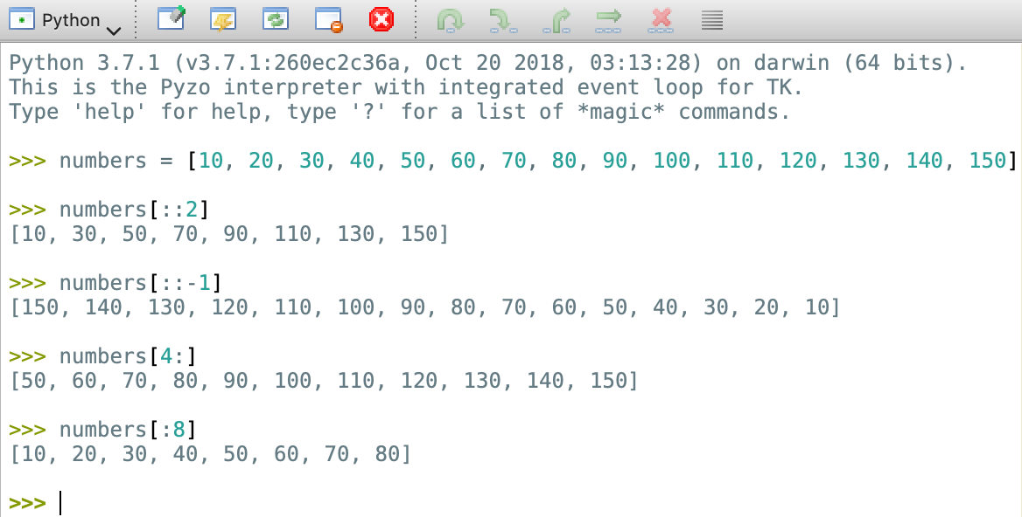
Slicing
Omitting parameters will result in Python using their default values.
The example:
numbers[0:len(numbers):2]
could also be written as:
numbers[::2]
With slice, you can easily create a reverse list. Try:
numbers[::-1]
Experiment giving start or end indexes only:
numbers[4:]
numbers[:8]

Slide 34
List concatenation and repetition

Slide 35
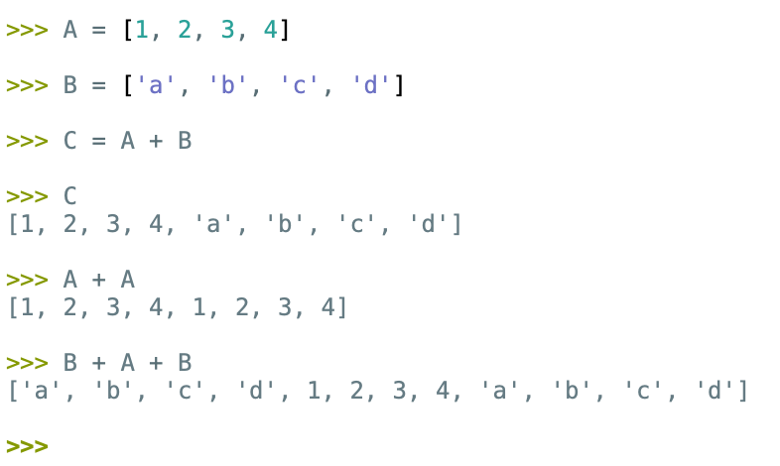
List concatenation (+)
Operator + is an overloaded operator. Similar to strings, when + is used with lists, it concatenates (adds) them.
Try:
A = [1, 2, 3, 4]
B = ['a', 'b', 'c', 'd’]
C = A + B
print(C)
print(A + A)
print(B + A + B)

Slide 36
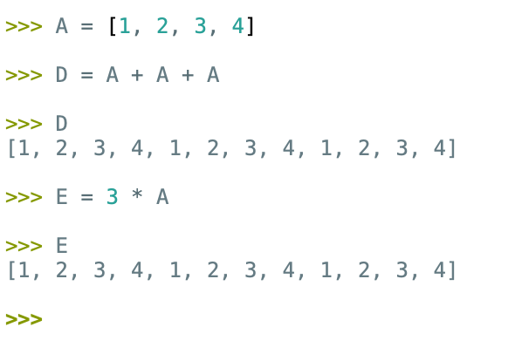
List repetition (*)
Python uses operator * for list repetition.
Try:
A = [1, 2, 3, 4]
D = A + A + A
print(D)
As A + A + A = 3A, the same can be achieved like this:
E = 3 * A
print(E)

Slide 37
Handy list methods
Reverse and sort

Slide 38
Handy list methods
Another way to reverse the order of elements in a list is to call its .reverse() method.
Sorting elements can be done using .sort() method.
Note: if a list contains characters, .sort() will use their character encoding values to determine their placings.
Method .count() will return the number of occurrences of the given element.

Slide 39
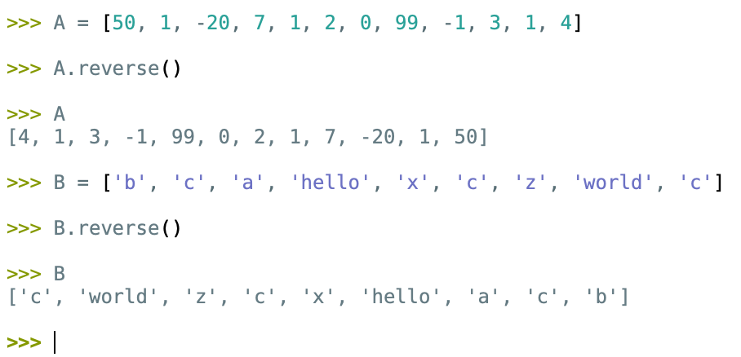
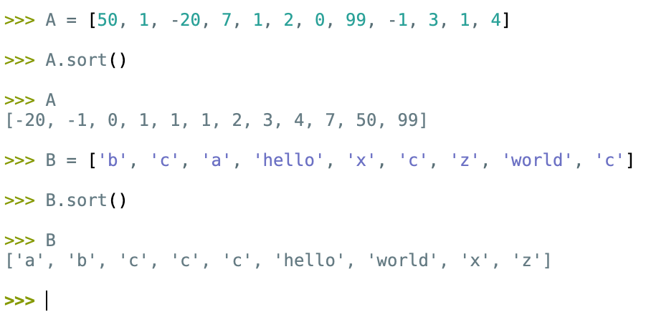
Handy list methods (examples)
.reverse()
.sort()

Slide 40
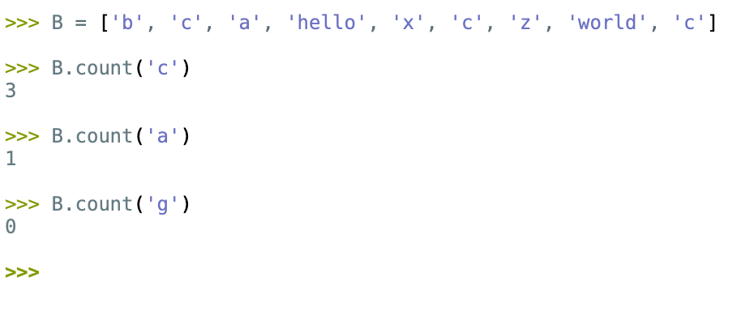
Handy list methods - .count()
Use .count() to get the number of occurrences of the desired item.
Try:
B = ['b', 'c', 'a', 'hello', 'x', 'c', 'z’, 'world', 'c’]
B.count('c')
B.count(‘a’)
B.count(‘g')

Slide 41
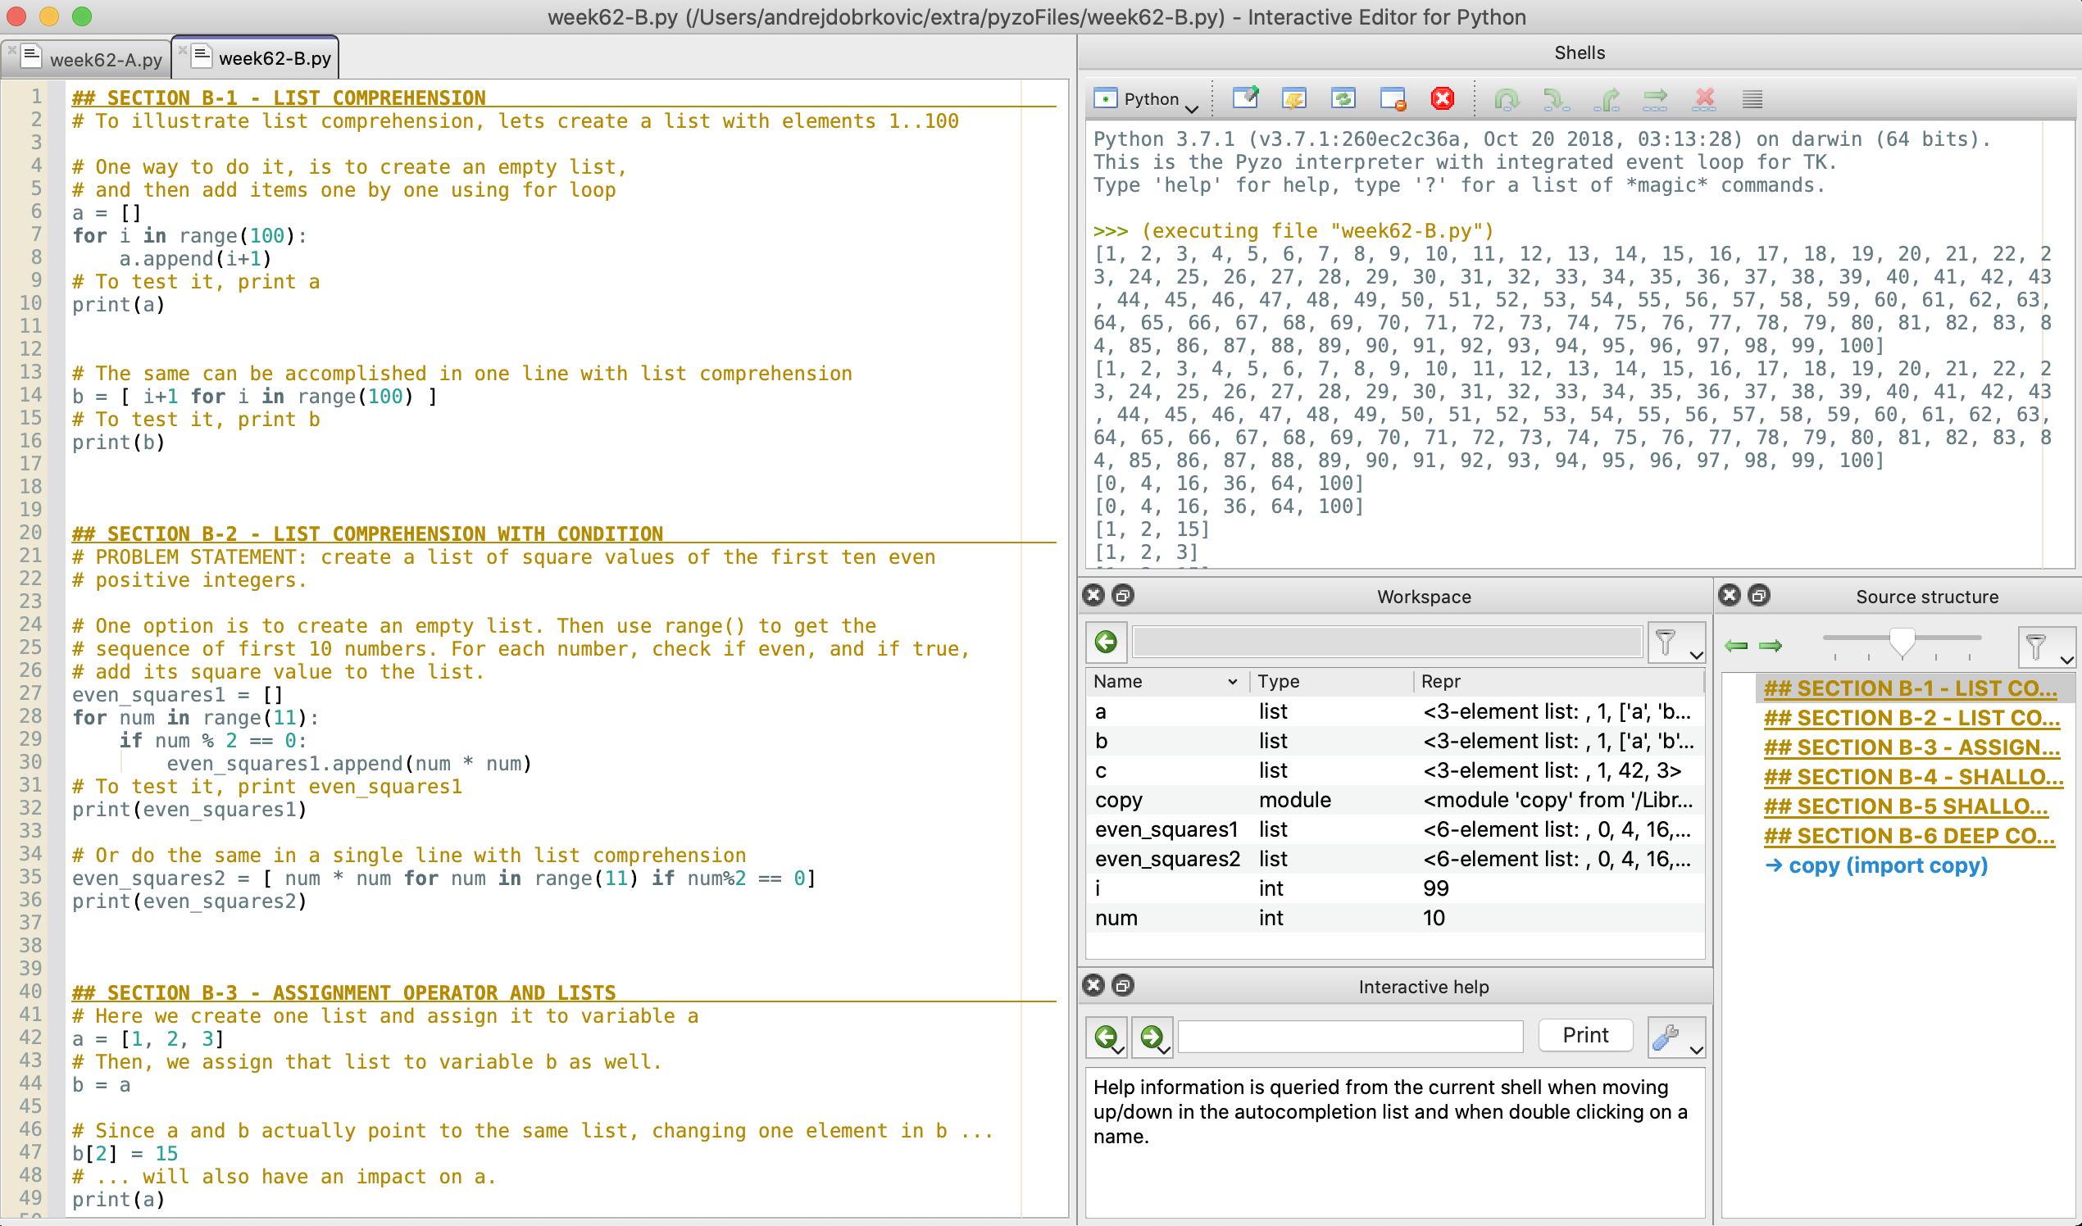
Code for list comprehension and list copy
Every example used in the remaining slides is also implemented in the file week62-B.py.

Slide 42
List comprehension (optional)

Slide 43
List comprehension (optional)
List comprehension in Python provides a concise way to create lists.
It consists of square brackets [ ] and inside:
expression,
for clause,
(optional) additional for clauses(s),
(optional) if clause(s).

Slide 44
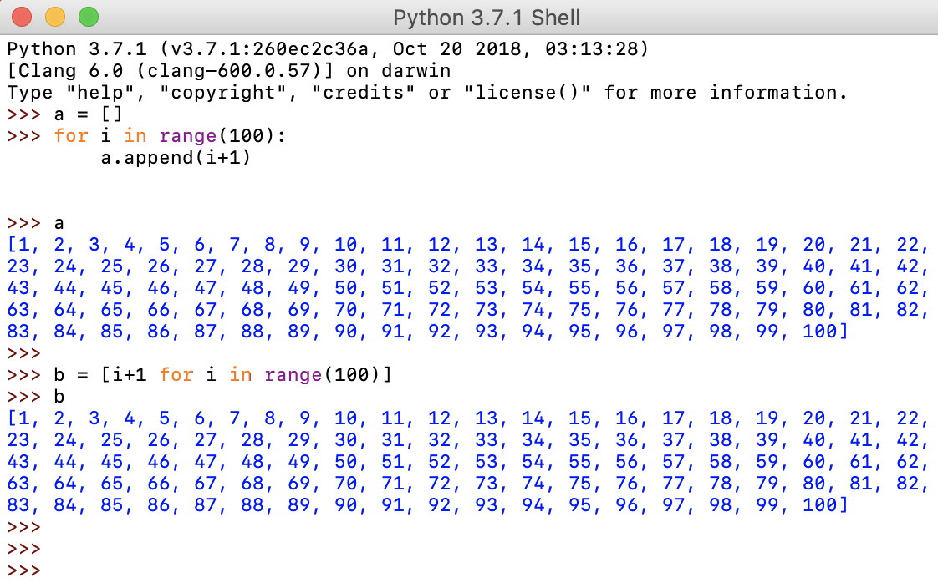
List comprehension (optional)

Slide 45
List comprehension (optional)
List comprehension must have one expression and one for loop. Optionally, additional loops and conditions can be added.
PROBLEM STATEMENT: Assume we want to create a list of square values of the first ten even positive integers.
A standard approach would be to:
Create an empty list,
Use for loop to iterate in range [0,10],
For each value of the iterator, check if it is even number (check if remainder when dividing by 2 is 0),
If #3 is true, get the square value of the iterator and add it to the list.
EXERCISE: Implement the above pseudo-code in Python.

Slide 46
List comprehension (optional)
* image source: towardsdatascience.com

Slide 47
Python object model (optional)
a brief overvieW
Notes:
Note to teachers: although this section is optional and will not be in the exam, giving students a brief overview will help understand how lists behave in Python, and the difference between assignment and copy.

Slide 48
Python object model
Although to the programmer, Python behaves like any other programming language, the way it internally handles variables is much different.
Assume we want to do the following:
define a variable X to hold an integer value,
assign to X an integer value 1.
change the value of X from 1 to 2.
define a variable Y to hold an integer value,
assign to Y the value of X
change the value of Y to 42.

Slide 49
Variables in statically typed language 1
In a statically typed language like C (C++, Java, …)
when executing the line:
int X = 1;
a compiler would do the following:
Allocate memory to hold integer,
Assign the value 1 to that memory location,
Bind the variable name X to that memory location.
X
Location: | 0x9f2
Value: | 1

Slide 50
Variables in statically typed language 2
Next, 2 is assigned to variable X.
X = 2;
a compiler would do the following:
Find the memory location of X,
Write 2 to that memory location.
X
Location: | 0x9f2
Value: | 1
X
Location: | 0x9f2
Value: | 2

Slide 51
Variables in statically typed language 3
Lets add another variable Y and assign to it the same value of X.
int Y = X;
a compiler would do the following:
Allocate memory to hold another integer,
Bind the variable Y to that memory location,
Find the memory location and …
then the value of variable X,
Assign that value to the memory location …
bound to Y.
X
Location: | 0x9f2
Value: | 2
Y
Location: | 0x9f7
Value: | 2

Slide 52
Variables in statically typed language 4
Finally, lets change to value of Y to another value, e.g. 42.
Y = 42;
a compiler would do the following:
Find the memory location of Y,
Write 42 to that memory location.
X
Location: | 0x9f2
Value: | 2
Y
Location: | 0x9f7
Value: | 2
Y
Location: | 0x9f7
Value: | 42

Slide 53
Python object model
Python treats all variables as pointers to data objects that contain:
type,
value,
reference count.
Lets investigate what happens when the same operations are performed in Python.

Slide 54
Python object model 1
In Python, executing the line:
>>> X = 1
results in following:
Create a PyObject,
Set the type code to integer for the PyObject,
Set the value to 1 for the PyObject,
Create a variable called X,
Point X to the new PyObject,
Increase the refcount of the PyObject by 1.
Python variable
X
PyObject
Type: | integer
Value: | 1
Ref. count: | 0
PyObject
Type: | integer
Value: | 1
Ref. count: | 1

Slide 55
Python object model 2
Next, 2 is assigned to variable X.
>>> X = 2
Python will do the following:
Create a new PyObject,
Set the type code to integer
for the PyObject,
Set the value to 2 for the PyObject,
Point X to the new PyObject,
Increase the refcount of the new PyObject by 1.
Decrease the refcount of the old PyObject by 1.
Python variable
X
PyObject
Type: | integer
Value: | 1
Ref. count: | 0
PyObject
Type: | integer
Value: | 1
Ref. count: | 1
PyObject
Type: | integer
Value: | 2
Ref. count: | 0
PyObject
Type: | integer
Value: | 2
Ref. count: | 1

Slide 56
Python object model 3
We add Y and assigning to it variable X.
>>> Y = X
Python will do the following:
Create a variable called Y,
Point Y to the PyObject
X is pointing to,
Increase the refcount of
the PyObject by 1.
Python variable
X
PyObject
Type: | integer
Value: | 1
Ref. count: | 0
PyObject
Type: | integer
Value: | 2
Ref. count: | 2
Python variable
Y
PyObject
Type: | integer
Value: | 2
Ref. count: | 1

Slide 57
Python object model 4
PyObject
Type: | integer
Value: | 42
Ref. count: | 1
PyObject
Type: | integer
Value: | 42
Ref. count: | 0
Finally, 42 is assigned to variable Y.
>>> Y = 42
Python will do the following:
Create a new PyObject,
Set the type code to integer
for the PyObject,
Set the value to 42 for the PyObject,
Point Y to the new PyObject,
Increase the refcount of
the new PyObject by 1.
Decrease the refcount of the old PyObject by 1.
Python variable
X
PyObject
Type: | integer
Value: | 1
Ref. count: | 0
PyObject
Type: | integer
Value: | 2
Ref. count: | 1
Python variable
Y
PyObject
Type: | integer
Value: | 2
Ref. count: | 2

Slide 58
Python object model 5
PyObject
Type: | integer
Value: | 42
Ref. count: | 1
Depending on the settings and the available memory, at one point, garbage collector will remove PyObject with refcount 0.
Python variable
X
PyObject
Type: | integer
Value: | 1
Ref. count: | 0
Python variable
Y
PyObject
Type: | integer
Value: | 2
Ref. count: | 1

Slide 59
Assignment vs copy
Shallow and deep copy

Slide 60
Binding to a mutable object
In Python, every list is a data object.
All elements of a list are contained within that data object.
The moment the assignment operator ( = ) is used, a variable on the left-hand side is bound to a data object on the right-hand side.
Therefore, if two or more variables are bound to the same, mutable (can be changed) object, making change on the object using one variable, will reflect on all other bound variables.

Slide 61
Assignment operator and lists
We create one list object [1, 2, 3] and bind it to variable a using =.
Expression b = a, binds variable b to the same object.
Consequently, changing b will impact a.

Slide 62
Shallow copy
A shallow copy constructs a new compound object, and then inserts references into it, to the objects found in the original.
In contrast to the assignment, shallow copy creates a new object. Therefore, changes to the new list won’t affect the original.
List method .copy() or slicing entire list [:] creates a shallow copy.

Slide 63
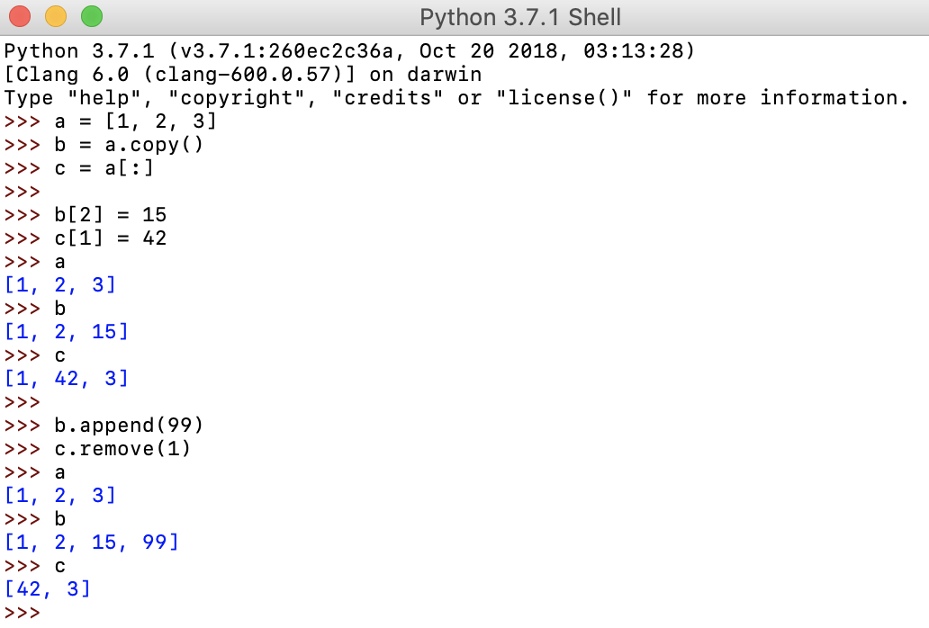
Shallow copy
As long as the elements in the original are non-mutable objects, making changes to copied object won’t affect the original.

Slide 64
Shallow copy
However, accessing and changing mutable object in the copy, will also affect the original.

Slide 65
Deep copy
A deep copy constructs a new compound object. Then, into it, recursively inserts copies of the objects found in the original.
Regardless what changes have been made to the deep copy, it will never affect the original.
Note: use of deep copy requires import of copy module*.
*(module import will be explained in Analysis 2)

Slide 66
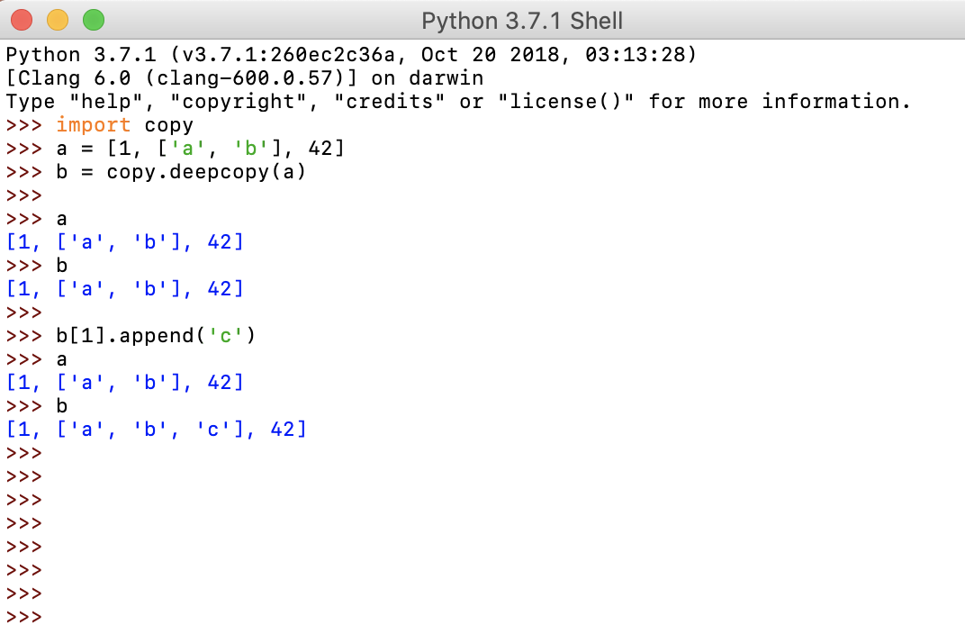
Deep copy
Changes made to the objects created by deep copy will never affect the original.

Slide 67
Assignment, shallow, deep copy

Slide 68
Summary Quiz
What is a list in Python?
What is a list member?
How can you create list in Python?
What are the main benefits of using lists in your program?
How do you access list members?
How do you count the number of elements in a list?
Which operator is used to test list membership?
How do you add elements to a list?
How do you remove elements from a list?
What is list slicing in Python?
What do operators + and * do when used with lists?

Slide 69
Summary Quiz
What is a list comprehension in Python?
What are the required and what are the optional parts of list comprehension syntax?
What is the main difference between list assignment and list copy?

Slide 70
Summary
List is a mutable ordered sequence of elements.
Each value contained inside a list is called an item or a member.
List can be created as an empty list using list() command, or by listing all values, separated by commas between square brackets.
The main benefits of using lists are: keeping data together, ability to perform same methods and operations on multiple values at once, and condensed code.
Elements in list are accessed using indices, either positive (starting from the beginning) or negative (starting from the end).
Elements in list are counted using len() function.
Operator in is used to test membership of an element in a list.
The methods to add element to a list are .append() and .insert(). Append will add the element to the end, while insert will insert the element at the given position.
There are three options to remove an element from a list. Command del() can be used, or methods .remove() or .pop().

Slide 71
Summary
Slicing is a quick way of retrieving a subset of items from a list. Inside of curly brackets, you define start and end index separated by colon, and optionally step value.
Operator + is used for list concatenation, while operator * is used for list repetition.
A List comprehension is a syntactic construct in Python that allows to create a list in a single line of code.
The required part of list comprehension is the expression, followed by for clause. Optionally, there can be additional for clause(s) and one or more if clause(s) at the end.
The main difference between assignment and copying lists in Python is that by assigning multiple variables to the same list, makes the change in one reflect on all the others. Copying, in general sense, creates a new object, so that the changes in the copy do not influence the original.

Slide 72
Extra material - videos
Disclaimer:
The following videos are not part of the course material, and as such, are treated as an extra information. The teaching team believes it is beneficial to the students to also have the topics presented from a different perspective. Some video will provide more information that given at the lesson, some less.
For the exam, the only relevant information is considered the one given by the teachers and written in the course book.
To understand the topics better, using external sources, like the videos given below, is strongly recommended. Feel free to explore, and ask your teacher should you have any questions.

Slide 73

Python lists
Notes:
URL:
https://www.youtube.com/watch?v=ohCDWZgNIU0

Slide 74

List comprehension
Notes:
URL:
https://www.youtube.com/watch?v=AhSvKGTh28Q

